Slide 1
“PASSWORD GENERATOR”
TS- WEB TRACK CAPSTONE PROJECT
Presented By:
Kothakapu Anupriya 19PT1A0520
Dornala Nikitha 19PT1A0507
Guided By: Uma Maheshwari

Slide 2
CONTENTS
Abstract
Objective
System Architecture
Flow Chart
Design Methodology
Advantages
Conclusion
References

Slide 3
Abstract
A password generator is a software tool that creates random or customized passwords for users.
These programs produce complex/strong passwords with combinations of numbers, uppercase and lowercase letters, and special characters such as braces, asterisks, slashes, etc.
Password generators help those who have to constantly come up with new passwords to ensure authorized access for programs.

Slide 4
Objective
The main objective of the study is to develop a password generator.
For a secure and strong password reminder the following:-
Never use personal information.
Include a combination of letters, numbers, and characters.
Prioritize password length.
Never repeat passwords.
Avoid using real words.

Slide 5
System Architecture
The architecture of a random password generator typically involves the following components:
User Interface
Random Number Generator
Password Generator Logic
Password Strength Checker
Password Storage
Password Manager Integration

Slide 6
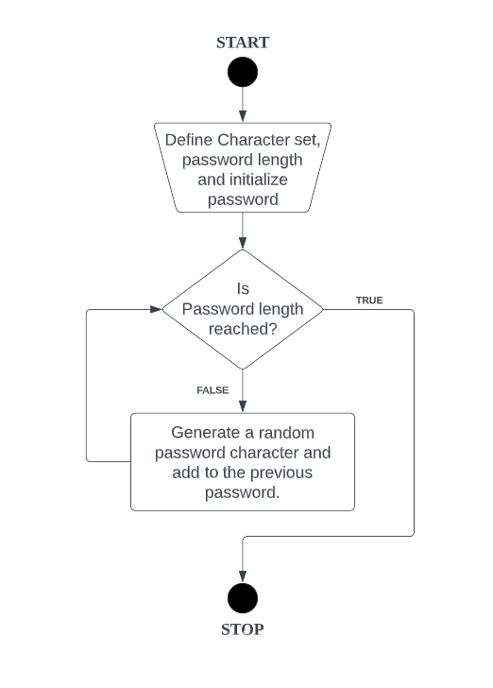
Flowchart

Slide 7
DESIGN METHODOLOGY
All characters should be stored as a list. This can be done by choosing the instructions manually
Ask the user for the length of the password.
Iterate password length to generate the password
Randomize the resultant list of passwords.
Use the generate method to create a string from the list of passwords.
Print the password.

Slide 8
Advantages
1. Minimal Effort. 2.Secure & strong password. 3.Less time consuming. 4.Fast response. 5.complex for hackers.

Slide 9
Conclusion
The password generated using the alpha-numerical random password mechanism that was illustrated above is practical and can be used with great results.
This gives the space for the intruders to deploy various attacks in breaking the passwords.

Slide 10
References
https://www.geeksforgeeks.org/
https://www.wikipedia.org/
https://github.com/

Slide 11
THANK YOU

